Slide 1
AI technology Impact

Slide 2
Scenario: You are a IT Trainee in a software development company that recently observed the new trainees are more focused on using the help of AI technology . You are tasked with presenting a case study on how this AI technology affects the employees creativity and how it should be used for reference. You are given 10 minutes to present. You will be presenting to new upcoming fresher trainees..
Case study

Slide 3
Basic Understanding about
AI
Artificial intelligence is the science of making machines that can think like humans. It can do things that are considered "smart."
AI technology can process large amounts of data in ways, unlike humans.
The goal for AI is to be able to do things such as recognize patterns, make decisions, and judge like humans.
AI works by combining large amounts of data with fast, iterative processing and intelligent algorithms, allowing the software to learn automatically from patterns or features in the data.

Slide 4
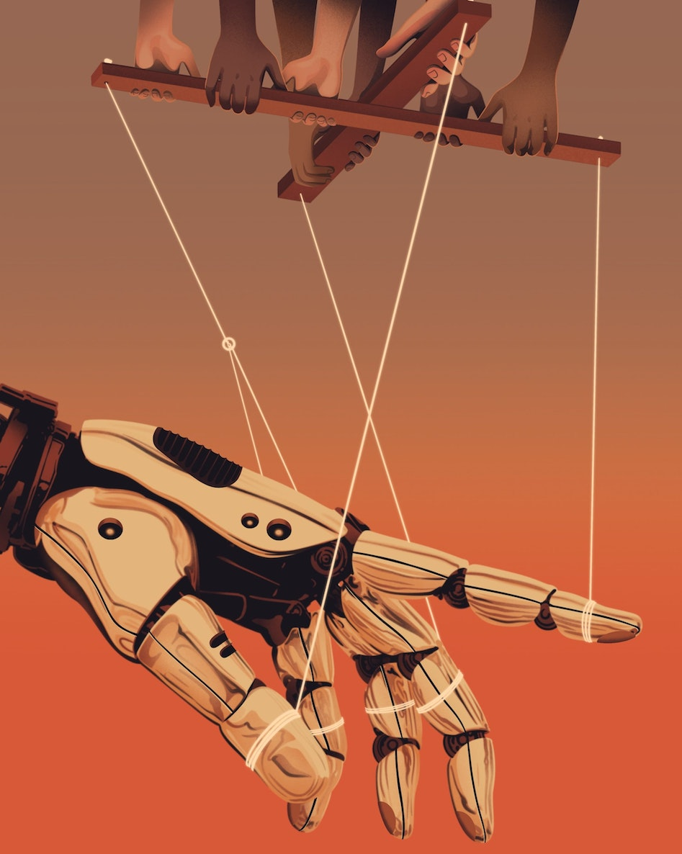
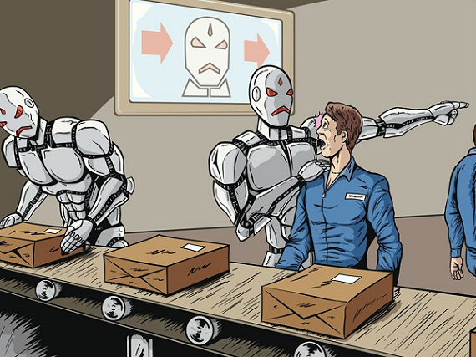
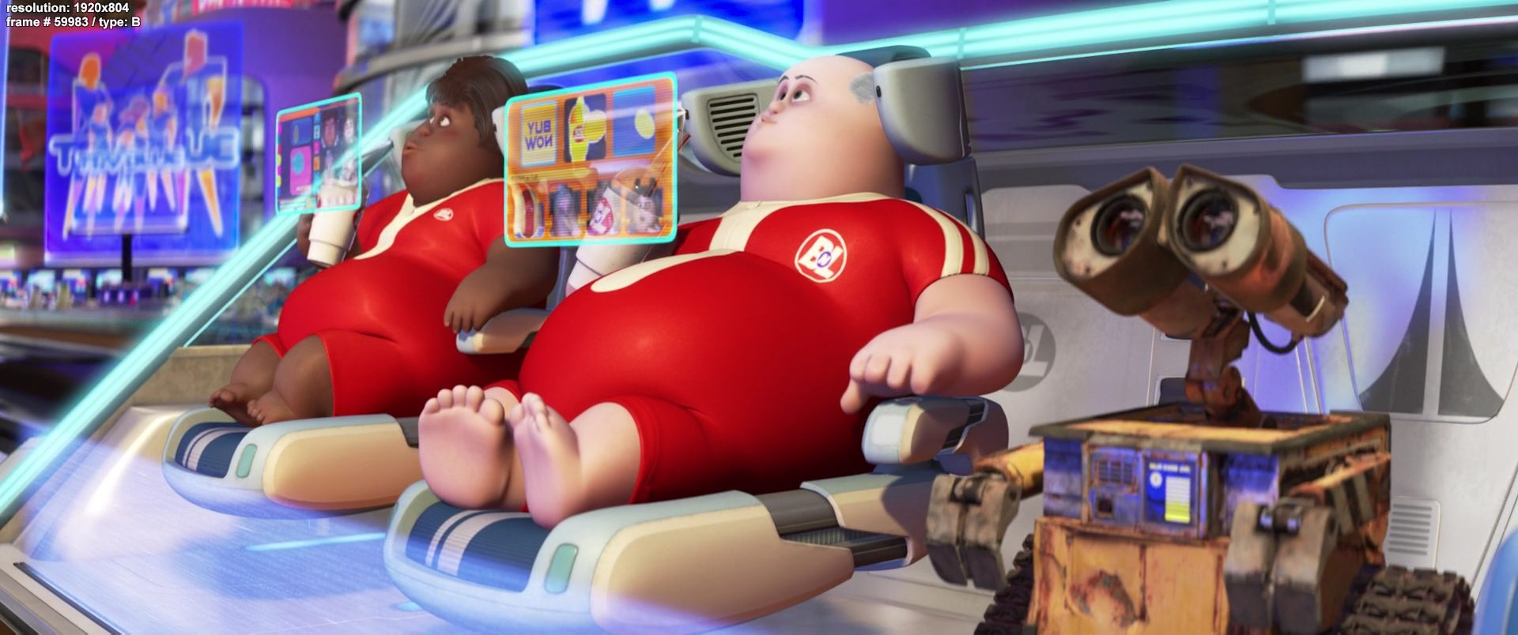
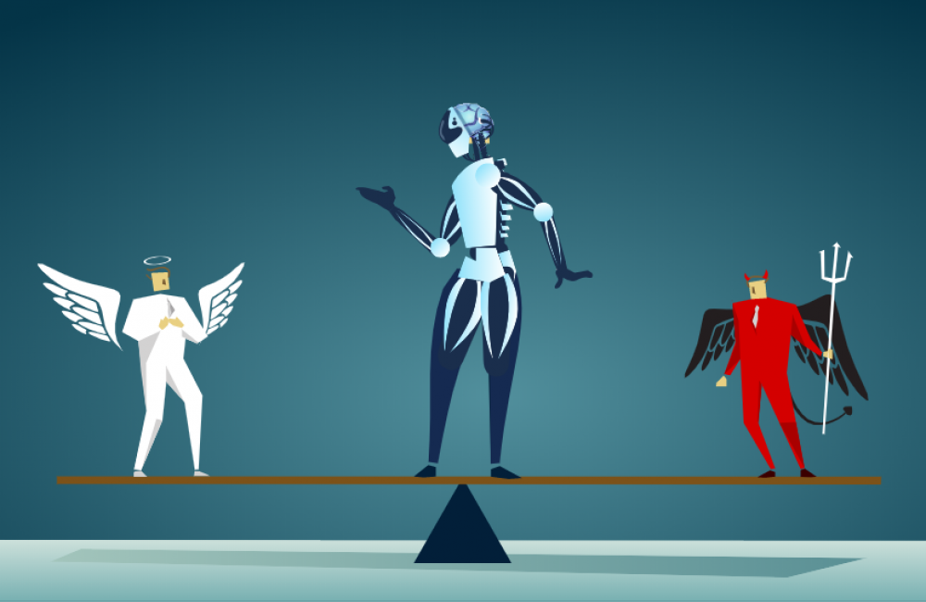
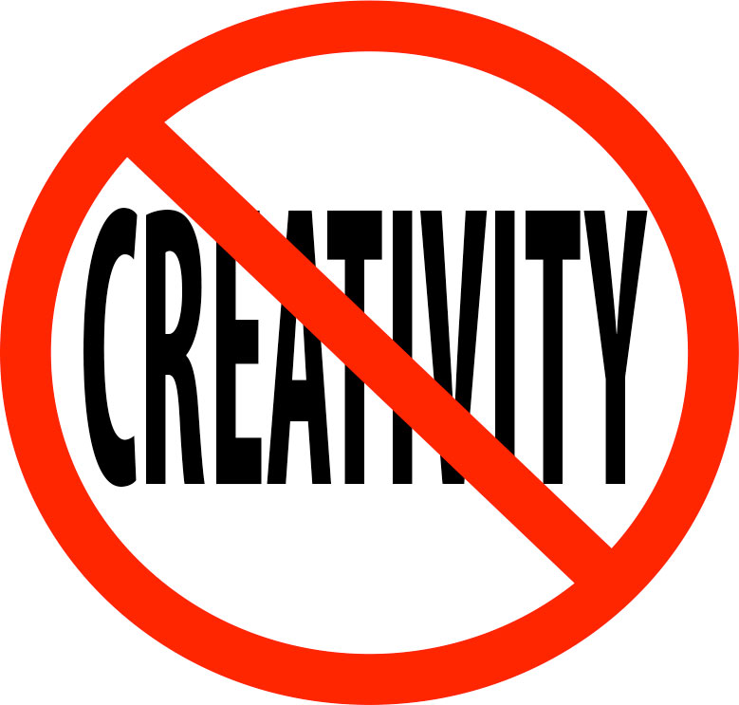


Disadvantages
1. High Costs
2. No Creativity
3. Unemployment
4. Make Humans Lazy
5. No Ethics
6. Emotionless
7. No Improvement

Slide 5
The impact of AI on employee creativity can be seen from different perspectives:
Augmentation of Work: AI can be used to augment human work, leading to greater productivity. This means that AI can assist human employees in increasing their creativity. For instance, high-skilled employees creativity increased on average with AI assistance.
Disruption of Content Creation: Generative AI applications such as ChatGPT and Midjourney are threatening to significantly alter creative work, both independent and salaried . This could lead to a flood of cheap content that might drive out human creatives .
Demand for Human-made Creative Work: Despite the rise of AI, human-made creative work might still demand a premium. This is because creativity is often held up as a uniquely human quality.

Slide 6
Change in Nature of Jobs: AI-driven automation will likely change the nature of how many humans conduct their jobs. Employees should aim to embrace an attitude of lifelong learning and consider how AI assistance may supercharge their work in the future.
Impact on Lower-skilled Employees: The benefits of AI assistance were limited for lower-skilled employees. When implementing AI, organizations must make sure that low-skilled employees are not left behind.

Slide 7
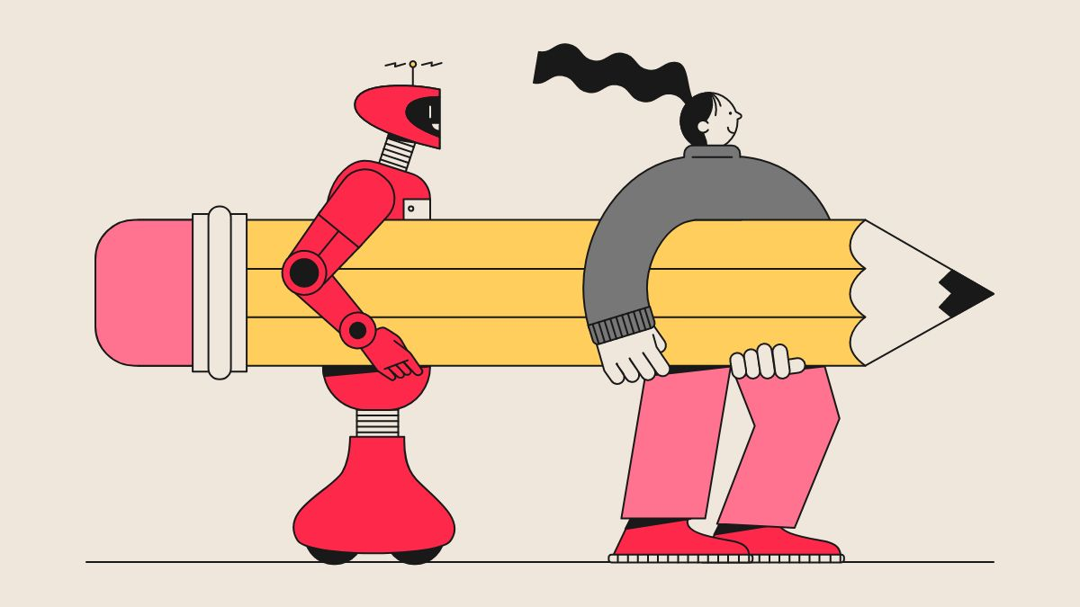

Slide 8

Conclusion
In conclusion, while AI has the potential to disrupt creative work, it can also augment it and lead to greater productivity. The key is to ensure that all employees, regardless of skill level, are able to benefit from these technological advancements.

Slide 9

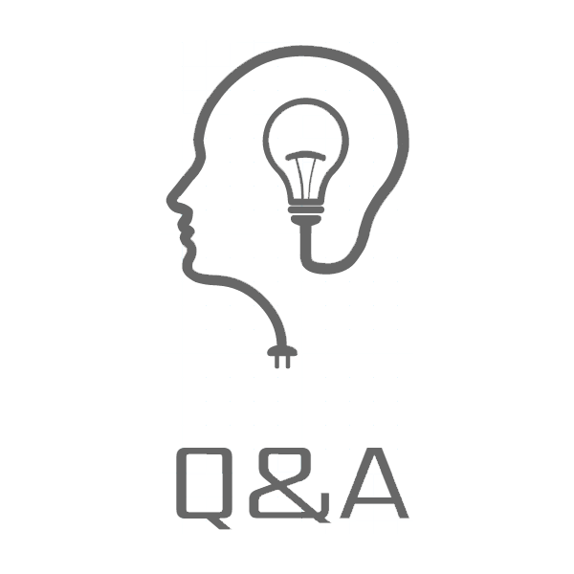

Slide 10
Kathirvel Selvam

